Slide 1

Research Progress Record
Enmao Diao
Feb 05, 2019

Slide 2
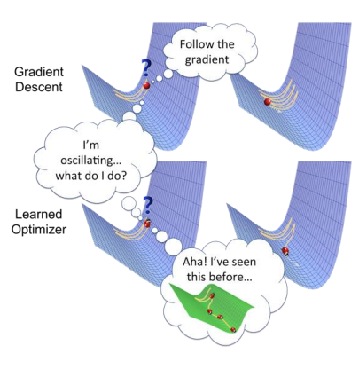
Last Milestones
General
Better tuning parameter strategy for optimization
Setting a milestone for each objective and adjust tuning parameter based on the distance between the milestone and the current performance
https://arxiv.org/pdf/1810.04650v1.pdf
Meta Learning
Use models to learn the learning rate and other hyper parameters (learn to learn)
Transfer Learning
Add hidden and memory state for the whole model
Growing Memory cell
Memory Issue
Test Truncated BPTT and models that consume less memory

Slide 3
Last Milestones
Compression and Classification
Experiment better classification performance
Test on ImageNet and Coco Dataset after memory issue fixed
Try to add support for varying image size
Test with large image shape with deeper models with ImageNet
Test with Kodak and RAID (raw images) dataset
Test with other metrics and PSNR-HVS and MS-SSIM
Add entropy codec and Compare with other classical codecs like JPG2000, BPG
Test dynamic functionality and performance
Test more multi-scale model
Test distributed codecs with smaller encoders
Test decoders for different number of nodes
Experiment smaller gap among the number of nodes
Experiment images from different angle for distributed systems
Start Video Compression

Slide 4
Last Milestones
Generative Codec and unsupervised learning
Experiment K-means and GMM for MNIST data with Gaussian VAE
Experiment Dirichlet Process GMM for gradually growing number of clusters (dictionary building)
Experiment Concrete VAE (Bernoulli distribution reparametrized by Gumbel Trick)
Combine Clustering, Concrete VAE and our codecs

Slide 5
Last Milestones
Compression and Detection
Combine Faster-RCNN with our codecs

Slide 6
Last Milestones
Other Tracks
Audio Compression, Music Information Retrieval and Speech Recognition
Web Crawler for crawling images from URL (data mining)

Slide 7
Data
MNIST dataset
60000 handwritten 0-9 digits images for training, 10000 for test
Original shape 28x28, resized to 32x32
CIFAR10 dataset (cannot exceed 30 PSNR and 74% accuracy)
50000 natural images of 10 classes like airplane, automobile, cat, dog, etc for training, 10000 for test
Original shape 32x32
SVHN dataset
Street View House Numbers data containing 0-9 digits RGB cropped images. 73257 digits for training, 26032 digits for testing, and 531131 additional (not used this time), somewhat less difficult samples, to use as extra training data.
http://ufldl.stanford.edu/housenumbers/

Slide 8
General
Fix bug in classification and DSC from last milestone
No need to tune the tuning parameter as long as we use probability to model the loss function (inspired by the variational inference loss)
Use validation method for learning rate decay, slightly improve the performance
Organic Network is very related to Transfer Learning and Group Convolution
Memory issue is hard to alleviate. Attempted GRU and multilayer convolution LSTM cell
JPEG and other classic codecs support finish with ImageMagick

Slide 9
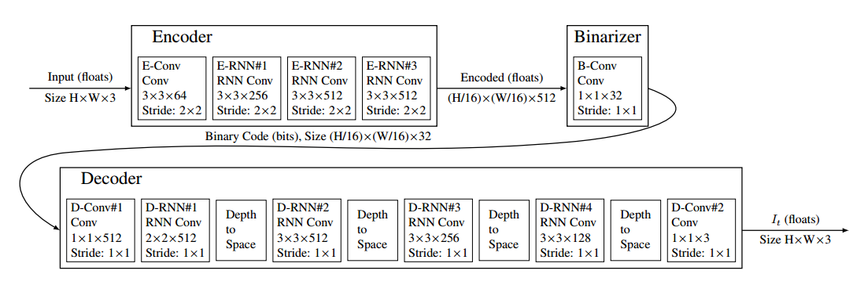
Model
Google Model

Slide 10
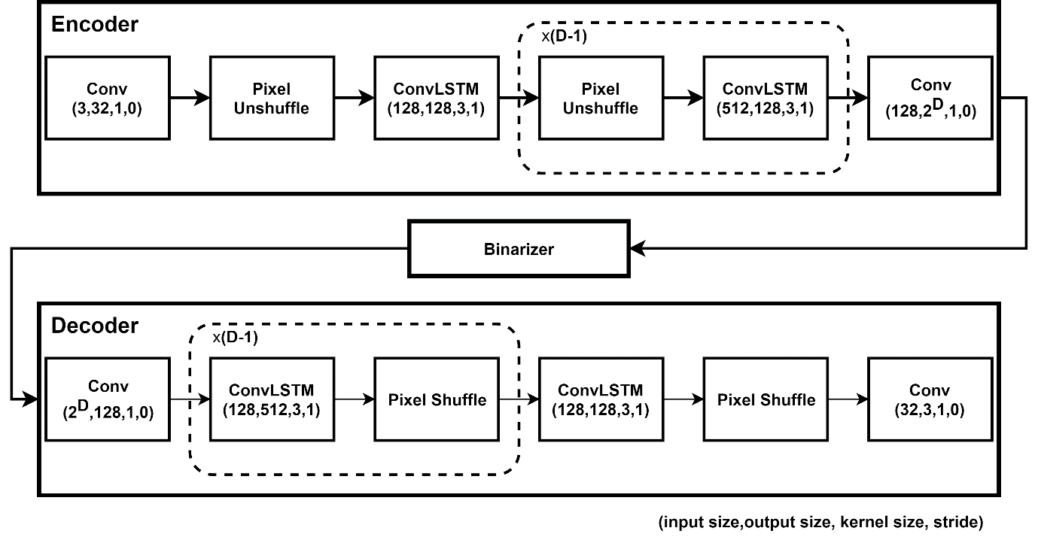
Model

Slide 11
Compression and Classification
CIFAR10 cannot achieve comparable results
Data augmentation
Model complexity is smaller than ResNet18
Add more convolutional LSTM layer will severely degrade the performance (untrainable)
Gradient vanishing problem solved by residual connection [1]
[1] Kim J, El-Khamy M, Lee J. Residual LSTM: Design of a deep recurrent architecture for distant speech recognition[J]. arXiv preprint arXiv:1701.03360, 2017.

Slide 12
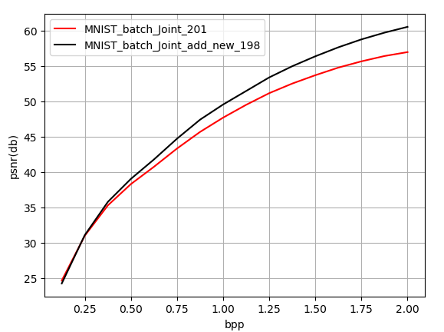
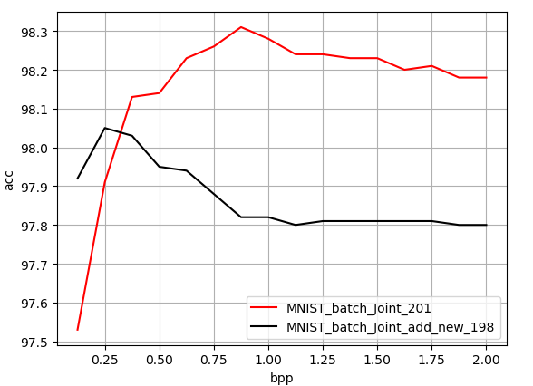
Compression and Classification
MNIST (last milestone)

Slide 13
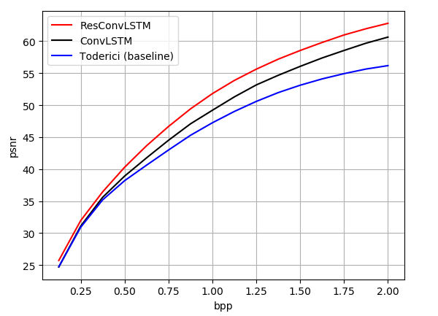
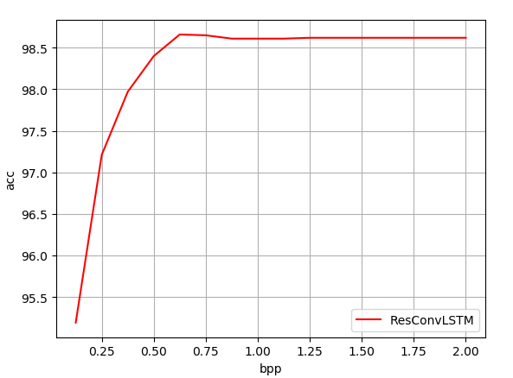
Compression and Classification
MNIST

Slide 14
Compression and Classification
MNIST

Slide 15
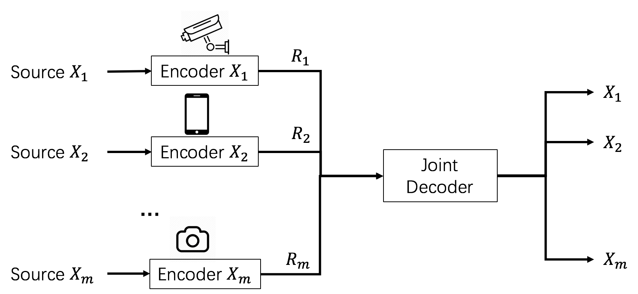
Distributed Codecs
Model

Slide 16
Distributed Codecs
Train on more nodes and test on less nodes
Smaller encoder
Different correlation, e.g. each source contains different classes of data
Distributed Encoder?

Slide 17
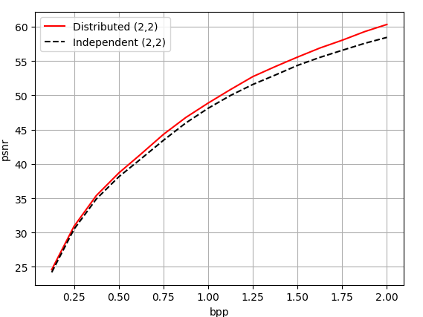
Distributed Codecs
Train on more nodes and test on less nodes
Train 2 nodes Test 2 nodes

Slide 18
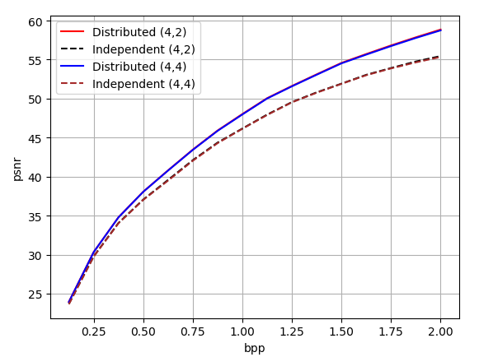
Distributed Codecs
Train on more nodes and test on less nodes
Train 4 nodes Test 4, 2 nodes

Slide 19
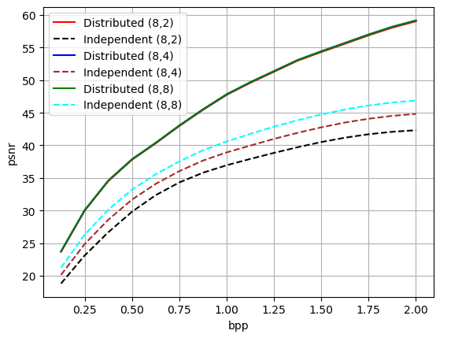
Distributed Codecs
Train on more nodes and test on less nodes
Train 8 nodes Test 8, 4, 2 nodes

Slide 20
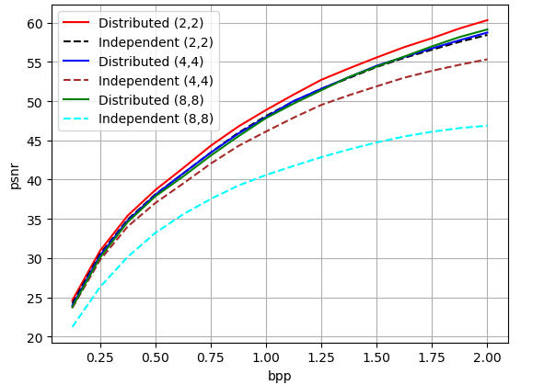
Distributed Codecs
Train on more nodes and test on less nodes
Train 8,4,2 nodes Test 8,4,2 nodes

Slide 21
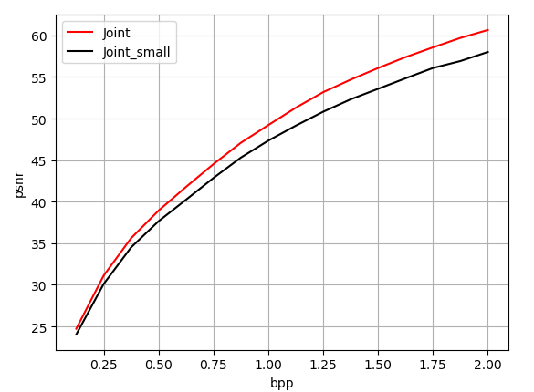
Distributed Codecs
Smaller encoder

Slide 22
Other Tracks (Active)
Compression and Clustering
Variational autoencoder for unsupervised classification verified
Extend to convolutional and binary codes
Extend to recurrent networks with variational LSTM

Slide 23
Other Tracks (Idle)
Organic Network
Fine-grained Classification
Fu J, Zheng H, Mei T. Look closer to see better: Recurrent attention convolutional neural network for fine-grained image recognition[C]//CVPR. 2017, 2: 3.
Image Detection on compressed domain
Image Caption on compressed domain
Hierarchical Classification
Speech Emotion Recognition
Speech Synthesis
Meta Learning

Slide 24
Milestones
Compression and Classification
Test on ImageNet
Test with Kodak and RAID (raw images) dataset
Test with other metrics and PSNR-HVS and MS-SSIM
Batch support for classic codecs like JPEG
Deep Learning based entropy codec
Experiment attention based Transformer network
Multitask with Organic Network
DSC
Experiment images source from different classes
Distributed Decoder
DSC for classification only

